Slide 1
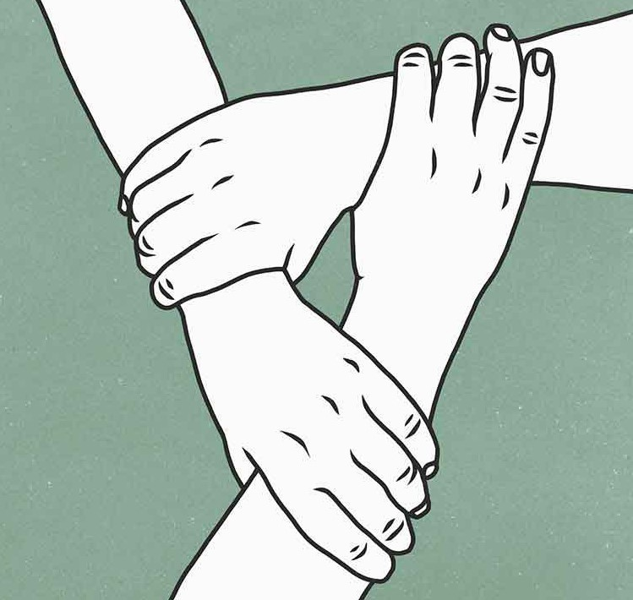
Providing Emotional Support
Presented by: Abdullah Tahir : 21L-5419 Ahsan Shafi : 21L-5429 M Abaidullah: 21L-5356 Usman Ramzan : 21L-5450

Slide 2
Outline
Comforting Guidelines
Managing Privacy and Disclosure

Slide 3
Comforting Guidelines
Clarify supportive intentions:
People have trouble trusting the motives of those wanting to help.
Buffer potential face threats:
Positive face needs are the desires we have to be appreciated
liked, and valued.
Give advice:
Presenting relevant suggestions for resolving a problem or situation.

Slide 4
Comforting Guidelines
Use other centred messages:
Other centred messages encourage those feeling emotional distress to talk about what happened and how they feel about it.
Reframe the situation:
Reframe the situation by offering ideas, observations, information, or explanations

Slide 5
Managing Privacy and Disclosure
Communication privacy management theory :
Decision-making process we go through as we choose whether or not to disclose confidential information about ourselves or about others.
Disclosure:
If your partner has your permission to share some of your personal information, then disclosing it to others is unlikely to affect your relationship.

Slide 6
Effects of Disclosure and Privacy on Relationships
Disclosure is the mechanism for increasing intimacy
Your disclosure is matched by similar disclosure from your partner
how partners treat the private information they know about one another

Slide 7
Conclusion

Slide 8
THANK YOU

